Slide 1

ÉPUBLIQUE ALGERIENNE DÉMOCRATIQUE ET POPULAIRE MINISTÈRE DE L’ENSEIGNEMENT SUPÉRIEUR ET DE LA RECHERCHE SCIENTIFIQUE UNIVERSITÉ DES SCIENCES ET DE LA TECHNOLOGIE HOUARI BOUMEDIENE FACULTÉ DES MATHÉMATIQUES
Faculty of Computer Science
Directed by :
GRAIA Ramine Mohammed Ryad
KENAZA Mouataz
DJAAFRI Haithem
SAIDOUNI Djoulene
RAHLI Zineddine
Academic year : 2023/2024

Slide 2
I. Introduction :
The report delves into major players in Information and Communication Technologies such as Google, Microsoft, Git, and GitHub, scrutinizing their functionalities, impacts, and collaborative dynamics. Google stands out with its ubiquitous suite and productivity tools. Microsoft offers powerful productivity-centric tools integrated into its Windows operating system. Git and GitHub revolutionize collaborative software development. The comparison reveals distinct strengths, from Google's versatility to Microsoft's productivity prowess and the collaborative innovation of Git and GitHub, all playing crucial roles in today's digital landscape.

Slide 3

II. Characteristics of Information and Communication Technologies:
Ubiquity :widely accessible across various aspects of life, work
, and society
Interconnectivity : Facilitates communication and connection
between different devices.
Convergence :Integration of traditionally distinct technologies.
Digitization : Information is represented in digital form, enabling
easy storage.
Automation :Enables the automation of processes and tasks
Multifunctionality :ICT systems often serve multiple functions

Slide 4
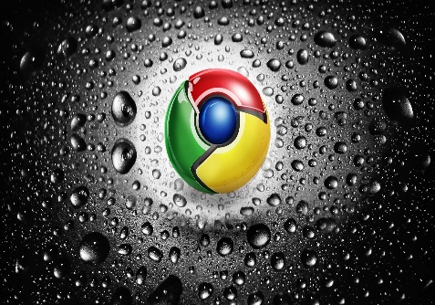
III. Introducing TIC services
Google services : Google's suite of services shapes seamless and comprehensive digital experiences. From the ubiquitous Google Search for information retrieval to Gmail's feature-rich communication platform, and Google Drive's seamless cloud storage, each service plays a pivotal role. Productivity tools like Docs, Sheets, and Slides foster collaborative document creation. Google Calendar manages time efficiently, Photos organizes multimedia content, and Chrome's speed integrates services seamlessly. Translate breaks linguistic barriers, Assistant uses AI for voice interactions, and YouTube dominates video sharing. Classroom aids online learning, Ads, and Analytics empower businesses. This diverse array caters to global user needs.
exemples :
Google Search:
The ubiquitous search engine for information retrieval.
Gmail:
A widely-used email service with feature-rich communication capabilities.
Google Maps:
Mapping and navigation services, guiding users through digital and physical spaces.

Slide 5


Slide 6


Slide 7

Microsoft's suite of software applications plays a pivotal role in both professional and personal spheres. Microsoft Office Suite stands as a cornerstone, encompassing widely-used applications like Word, Excel, and PowerPoint, offering indispensable tools for document creation, data analysis, and presentations. Power BI, another essential application, empowers businesses with data analysis capabilities, enabling them to visualize and share insights for informed decision-making. In the realm of software development, Visual Studio serves as a comprehensive integrated development environment (IDE), facilitating the creation of applications and software solutions. Each of these applications contributes significantly to the efficiency and productivity of users across various domains.
➢Microsoft profoundly influences both professional and personal realms.
Professional Impact: The Microsoft Office Suite is pivotal in businesses globally, serving as a cornerstone for document creation, data analysis, and presentations. Microsoft Teams transforms teamwork with unified communication and real-time collaboration, revolutionizing how teams operate.
Personal Influence: In personal lives, Microsoft's impact is seen through essentials like the Windows operating system and the versatile Office suite, managing daily tasks and creative endeavors. In entertainment, products like Xbox provide immersive gaming experiences. Communication tools like Skype enhance personal and business interactions, exemplifying Microsoft's pervasive influence in daily life.

Slide 8
V. Git/GitHub analysis ➢ understanding git/GitHub relation to TI
Git and GitHub play a central role in the Information and Communication Technologies (ICT) landscape, redefining collaborative software development. Git, as a decentralized version control system, empowers developers to track changes efficiently. GitHub, built around Git, provides a collaborative platform hosting repositories and streamlining the development process. In the context of ICT, this pairing enhances collaboration, ensures robust version control for software projects, fosters a global developer community, and accelerates the software development life cycle. Together, Git and GitHub embody the essence of seamless, collaborative, and accelerated software development in the ever-evolving field of ICT.
➢ impact of Git/GitHub on TIC
Git and GitHub wield significant influence in Information and Communication Technologies (ICT), reshaping software development. Git's decentralized version control system enhances collaboration, while GitHub accelerates development through global community contributions. This impact is characterized by streamlined collaboration, version control integrity, and heightened efficiency, making Git and GitHub pivotal tools in shaping the trajectory of ICT.

Slide 9


Slide 10
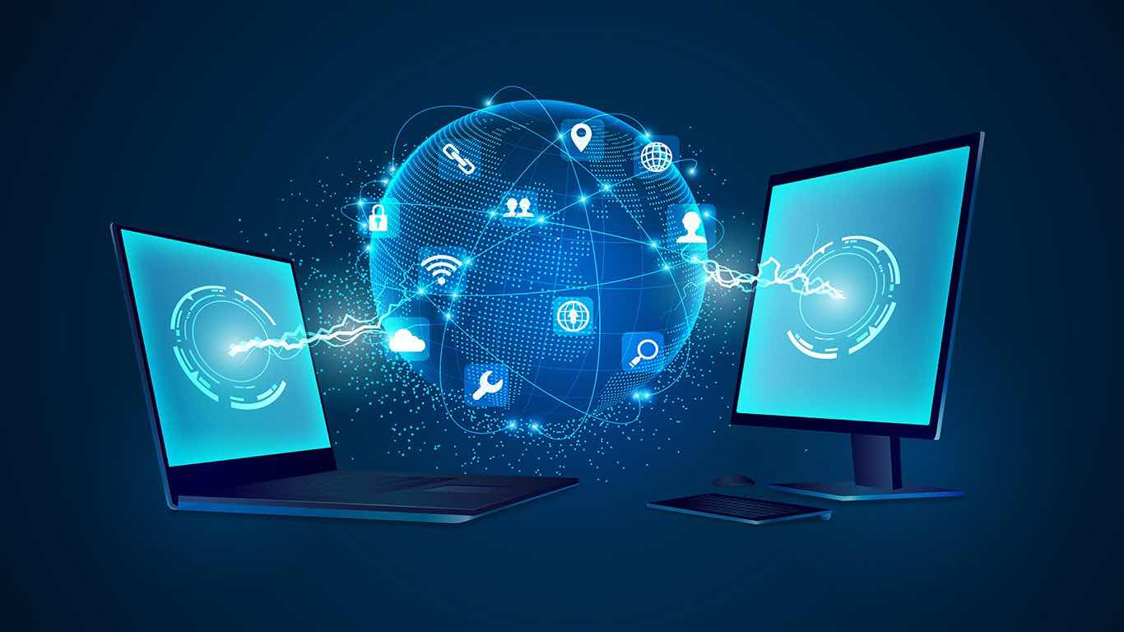

Slide 11
VI. TIC and his social impact small paragraph
Information and Communication Technologies (ICT) have significantly impacted society, revolutionizing communication, access to information, and business models. Social media platforms connect global communities, while ICT democratizes information, bridging digital divides. Remote work and e-commerce opportunities have emerged, transforming traditional structures. However, concerns about privacy, digital inequalities, and misinformation underscore the need for ethical considerations and digital literacy. As ICT evolves, its social impact emphasizes the importance of responsible technology integration for an inclusive and empowering societal future.

Slide 12
VII. Future trends of TIC
Future trends in Information and Communication Technologies (ICT) are poised to shape the digital landscape. Artificial Intelligence (AI) is expected to advance, enhancing machine learning capabilities and natural language processing. The widespread implementation of 5G technology will revolutionize connectivity, offering faster and more reliable communication. Cybersecurity measures will evolve to counter increasingly sophisticated threats, ensuring robust protection of sensitive data. The Internet of Things (IoT) will continue expanding, creating interconnected smart ecosystems. Quantum computing, though in its early stages, holds promise for transformative computational power. Sustainability and ethical considerations are likely to drive technological innovation, guiding the future of ICT towards responsible and impactful developments

Slide 13
VIII. Conclusion
In conclusion, we explored the influential landscape of Information and Communication Technologies (ICT), analyzing Google services, Microsoft tools, and the collaborative impact of Git/GitHub. From their functionalities to societal influence, each component shapes our digital age. Future trends in ICT, including AI, 5G, cybersecurity, IoT, and quantum computing, were highlighted, with a focus on sustainability and ethics. The social impact of ICT, emphasizing connectivity and responsible technology use, was also examined. This overview encapsulates the dynamic and influential role of ICT in our interconnected world.

